Slide 1
Software Project Scheduling
Subhash Paudel
MSCSKE, IOE, Pulchowk Campus
subhash@achsnepal.edu.np
Notes:
M.Sc. Computer Engineering, Computer System and Knowledge Engineering

Slide 2

Project Time Management-Activity Planning

Slide 3
Activity Planning – Activity + Planning
Activity – a set of one or more actions which upon completion lead the project to next state
Collection of activities results in final deliverable
Each activity has a start and end date upon which the task must be completed
Scheduling of each activity is activity planning

Slide 4
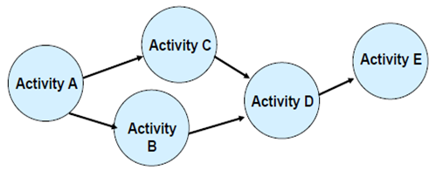
What happens as a result of Activity Planning? It leads to Project completion :
1. on minimal time
2. And at an acceptable costs
Note→ In any project, group the parallel activities and the serial ones.
Parallel activities will shorten project duration , while others require completion of previous activities

Slide 5
Activity and its sub activities for event planner system
Main and sub Activities
1.Mailing invitations
1.1 gather and confirm attendee’s address
1.2 print invitations
1.3 mail completed invitations
2.Booking the venue
2.1 price negotiation
2.2 Contract
3. Hiring a caterer
3.1…
3.2…

Slide 6
Why defining activities in a project is important?
Defining activities distinguishes particular task that needs to be finished with a specific objective → to produce the project deliverables. OR
Defining Activities involves the planning of a detailed depiction of the project and its significant deliverables.
The process should be done in adequate detail to estimate the resources and time that is required to complete.

Slide 7
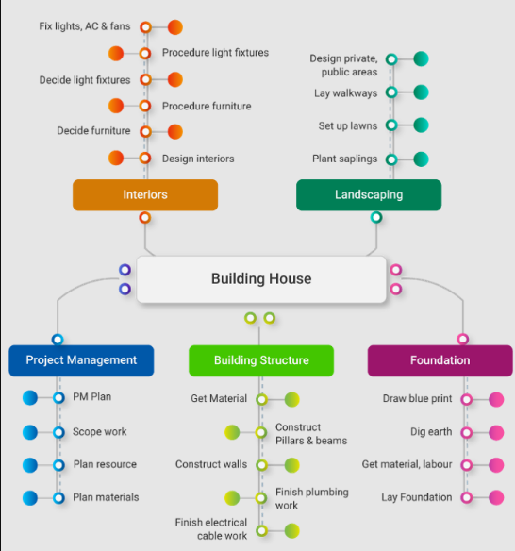
Defining Activity List → By creating an activity list for a project, you are ensuring proper functioning and the systematic progress of your project.
The milestone list :
1. Lay Foundation
2. Build Structure
3. Complete Interiors
4. Complete landscaping

Slide 8
Five-time management processes of the Activity list as per the PMBOK® guide:
Sequence Activities
Estimate Activity Resources
Estimate Activity Durations
Develop Schedule
Control Schedule

Slide 9
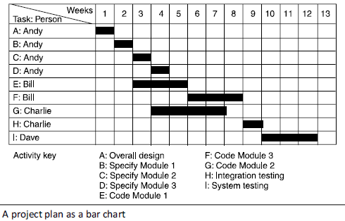
The benefit of Project scheduling →Below figure presents task/activity sequencing involving dependencies of tasks and when those tasks should take place

Slide 10
Activity sequencing after activities are defined
Once activities been defined, the project manager and other stakeholders need to sequence these tasks to place them in the appropriate order, and then track and manage them.
Activities are typically tracked with
either a network diagram, representing all the activities for a project in a sequential, workflow format
or a Gantt chart, which represents tasks via horizontal bars that demonstrate their length and duration.(refer previous figure)

Slide 11
Benefits of stating start and end date of each activity
ensure that the appropriate resources will be available precisely when required
avoid different activities competing for the same resources at the same time;
produce a detailed schedule showing which staff carry out each activity;
produce a detailed plan against which actual achievement may be measured;
produce a timed cash flow forecast;
Re-plan the project during its life to correct drift from the target.

Slide 12
Benefit of activity scheduling
Monitoring the project’s progress so that output of each activity are delivered on time
Easy to track the progress or any obstruction when something goes wrong →as a result we can easily identify the cause and review the plan to prevent its negative effect
In other words the activity plan quantifies the consequences of not meeting the task completion date and gives a direction on revising the project plan so that the project will be back on track

Slide 13
Objectives of Activity Planning
Feasibility Assessment →gives answer to the following question:
Is the project possible within given time and the available resource? (!!! remember an organization or any project has a limited number of resources and time not infinite!!!!)
Resource Allocation
What are the most effective ways of allocating resources within a given timescale of the project?
Detailed Costing
How much does the project cost and when is that particular expenditure likely to take place?
Producing an activity plan and allocating resource will lead to much better estimate of the project cost

Slide 14


Objectives of Activity Planning (contd.)
Motivation →Providing targets and being seen to monitor achievements against target is an effective way of motivating staff

Slide 15
Objectives of Activity Planning (contd.)
Coordination -When do the staff in different departments need to be available to work on a particular project and when do staff need to be transferred between projects?
!!! In situations where staff are concurrently working on more than one project, a set of integrated project schedules should ensure that such staff are available when required and do not suffer periods of enforced idleness.

Slide 16
The purpose of plan shifts at each successive iteration of the project
During the feasibility study and project start-up, the main purpose of planning will be:
to estimate time scales
And estimate the risks of not achieving target completion dates or keeping within budget.
But as the project proceeds beyond the feasibility study, the emphasis will be placed upon the production of activity plans for ensuring resource availability and cash flow control.
**** Throughout the project, until the final deliverable has reached the customer, monitoring and replanning must continue to correct any changes in the plan that might prevent meeting time or cost targets.

Slide 17
Project Schedule
The refined detailed plan of the project
showing dates of when each activity should start and finish (time)
and when and how much of each resource will be required. (resource)
4 main stages of Project Schedule Creation
What activities need to be carried out and in what order
Ideal activity plan construction – a plan when each activity would ideally be undertaken had resources not been a constraint.
This activity plan is generated by Steps 4 and 5 of Step Wise Project planning overview
The ideal activity plan will then be the subject of an activity risk analysis, aimed at identifying potential problems.
This might suggest alterations to the ideal activity plan and will almost certainly have implications for resource allocation
Resource allocation. The expected availability of resources might place constraints on when certain activities can be carried out, and our ideal plan might need to be adapted to take account of this

Slide 18
Project Schedule (Contd.)
Schedule production- After resources allocation to each activity has been done , need to draw up and publish a project schedule, which indicates planned start and completion dates and a resource requirements statement for each activity.
Summary Project Schedule Creation
Activity Identification and ordering
→Ideal Activity Plan Construction
→ Resource allocation
→ Schedule Production

Slide 19
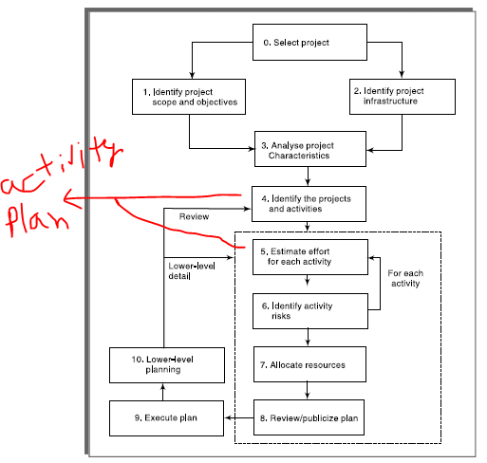
Activity Planning at step 4 and 5

Slide 20
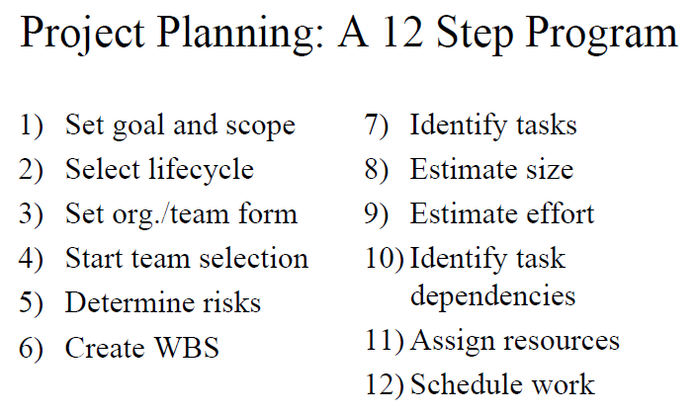

Slide 21
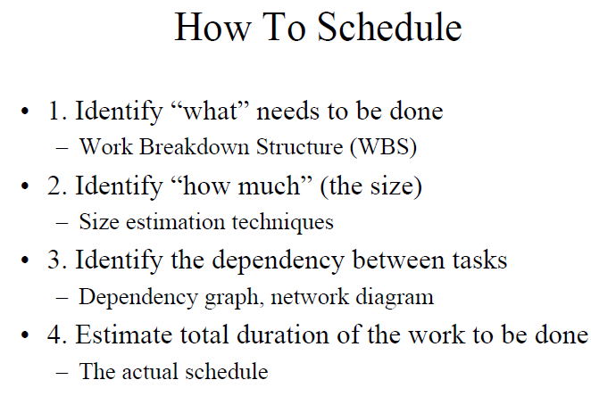

Slide 22
Project and its activities
A project is composed of a number of interrelated activities.
A project may start when at least one of its activities is ready to start.
A project will be completed when all of the activities it encompasses have been completed.
An activity must have a clearly defined start and end-point, normally marked by the production of a tangible deliverable.
If an activity requires a resource (as most do) then that resource requirement must be forecastable and is assumed to be required at a constant level throughout the duration of the activity.
The duration of an activity must be forecastable – assuming normal circumstances, and the reasonable availability of resources.
Some activities might require that others are completed before they can begin (these are known as precedence requirements).

Slide 23
Identifying Activities
3 ways to identifying activities in a project:
Activity based
Product Based
Hybrid approach

Slide 24
Activity Based Approach
In it list of all activities that the project is thought to go through are noted
Divide the project into main lifecycle stages and again consider each of the lifecycle separately
Work Break Down Structure (WBS) is one of those preferred activity based approach

Slide 25
Product Based Approach
Product Break Down Structure (PBS) and Product Flow Diagram
is a tool for analyzing, documenting and communicating the outcomes of a project, and forms part of the product based planning technique.
The purpose of this breakdown is to provide a visual representation of a products components and the relationship between those components
Show the deliverables
The PFD indicates, for each product, which other products are required as inputs
The PFD can therefore be easily transformed into an ordered list of activities by identifying the transformations that turn products into others.

Slide 26
Hybrid Approach
This approach structure both product and activities.
IBM recommended the following five levels Level
Project Level
Deliverables Level
such as software, manuals and training courses
Components Level
which are the key work items needed to produce deliverables, such as the modules and tests required to produce the system software.
Work-packages Level
which are major work items, or collections of related tasks, required to produce a component.
Tasks Level
which are tasks that will normally be the responsibility of a single person.
Notes:
Number of level imposed on the WBS

Slide 27
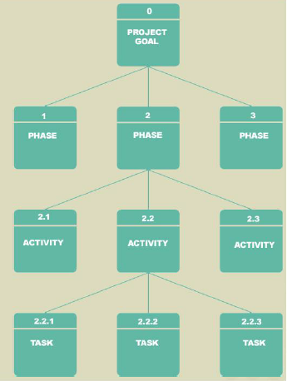

Work Breakdown Structure (WBS)
WBS is a graphical tool used to depict the hierarchical decomposition of the project into phases, activities, and tasks.

Slide 28
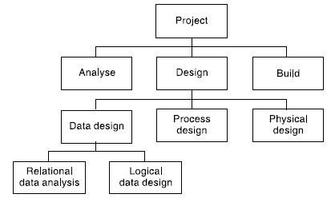
WBS
WBS involves identifying the main (or high-level) tasks required to complete a project and then breaking each of these down into a set of lower-level tasks.
Figure shows a fragment of a WBS where the design task has been broken down into three tasks and one of these has been further decomposed into two tasks

Slide 29
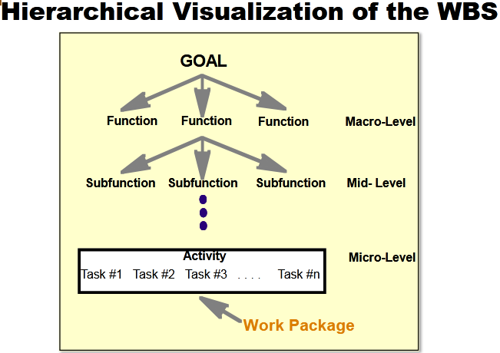
Hierarchical Visualization of the WBS

Slide 30
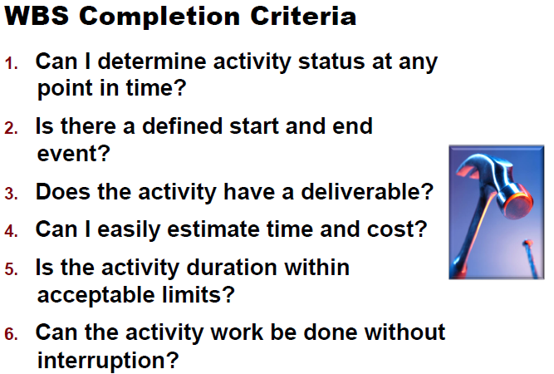

Slide 31
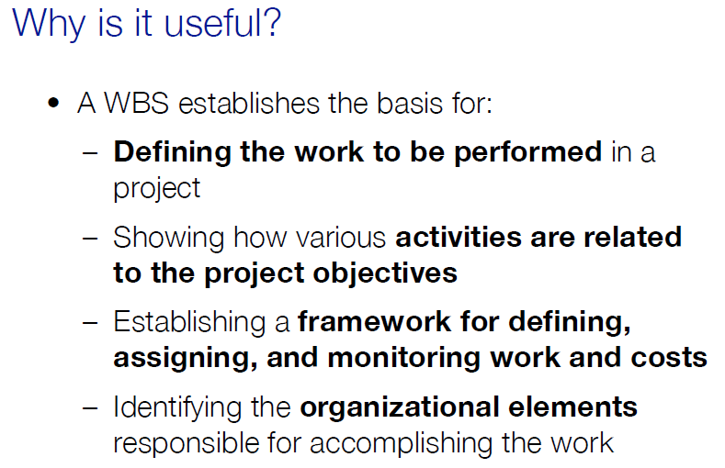
Why useful ?

Slide 32
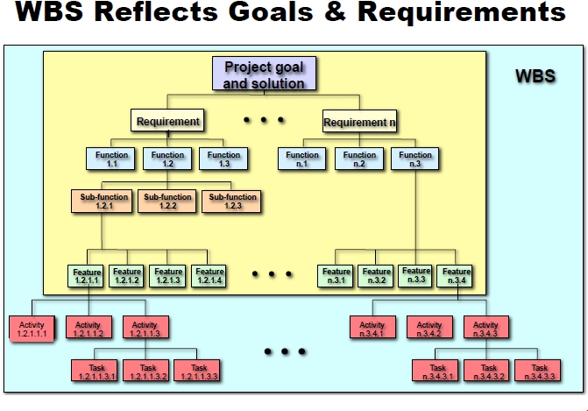
Work Breakdown Structure (WBS) is a hierarchical description of all of the work that must be done to meet the needs of the client.
Milestone – an event signifying the completion of a major project deliverable.

Slide 33
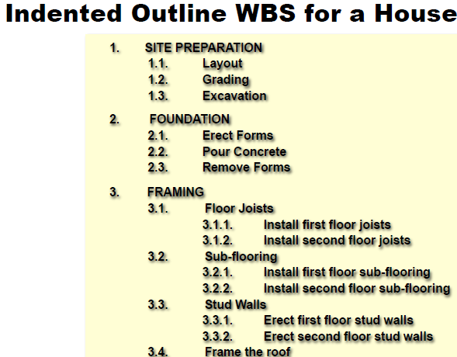

Slide 34
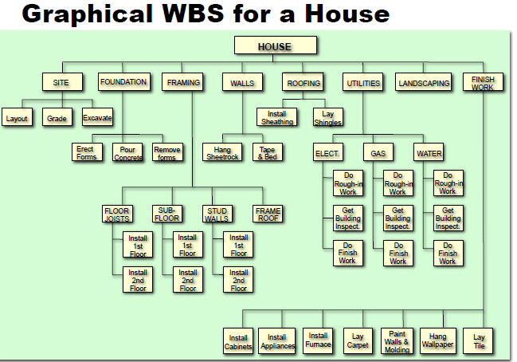

Slide 35
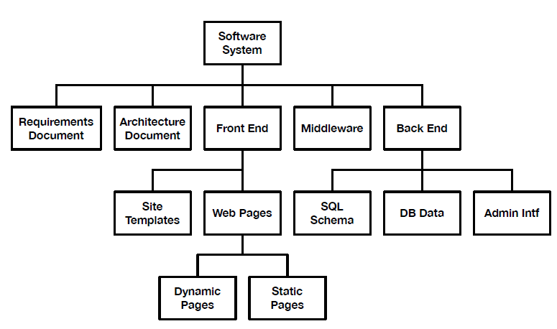
Product based WBS for a software system
It develops according to the structure of the output that need to be produced
It can start from a Product Breakdown Structure, when defined

Slide 36
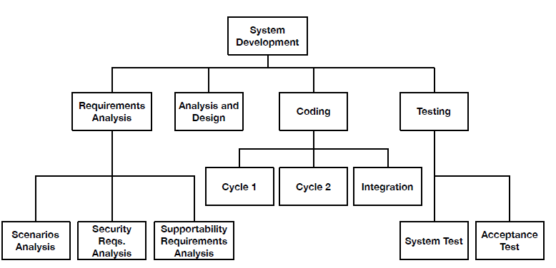
Process Based WBS
It develops according to the phases in which a project is organized For instance: Requirements, Analysis, Design, Testing

Slide 37
Hybrid WBS: both of Process and product based WBS
It mixes process and product
For instance: life-cycle phases at higher levels; component at
lower levels

Slide 38
To what level of depth WBS needs to show????
Too much depth will create difficulty in managing tasks
Too shallow depth will provide insufficiency in project control
So what level of depth?
The depth should be such that each branch can be extended to a leaf level where that task should be assigned to a particular person or responsible department within the organization

Slide 39
WBS Summary
WBS produces a task catalogue with non overlapping activities
WBS refinement once the project progresses
In the early part of a project we might use a relatively high-level or shallow WBS, which can be developed as information becomes available, typically during the project’s analysis and specification phases.
Once the project’s activities have been identified (whether or not by using a WBS), they need to be sequenced in the sense of deciding which activities need to be completed before others can start.

Slide 40
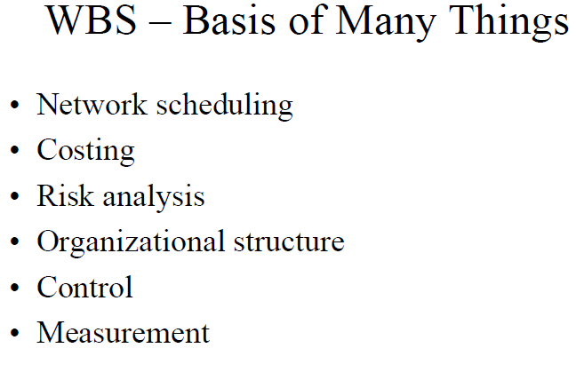

Slide 41
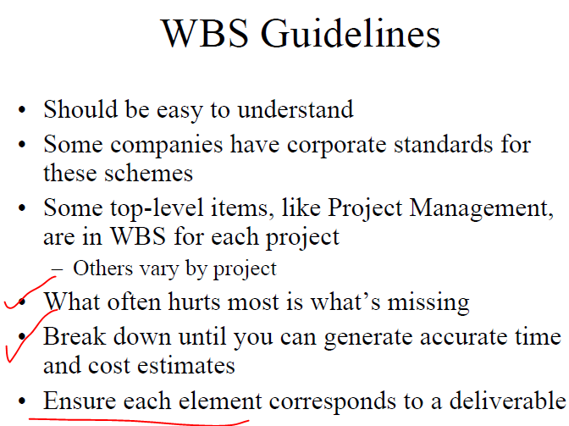

Slide 42
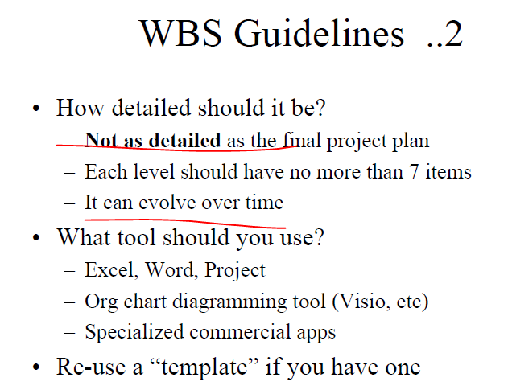

Slide 43
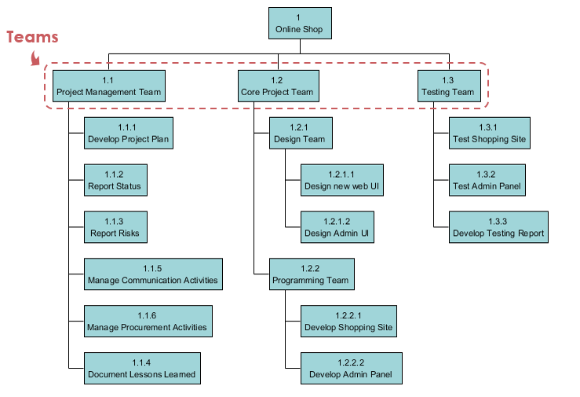
WBS online shopping store

Slide 44
Scheduling Fundamentals
The three most common forms of presenting a project schedule are:
Table
Gantt chart
Network diagram

Slide 45
Gantt Charts
Gantt Charts are useful tools for analyzing and planning complex projects. They:
Help you to plan out the tasks that need to be completed
Give you a basis for scheduling when these tasks will be carried out
Allow you to plan the allocation of resources needed to complete the project, and
Help you to work out the critical path for a project where you must complete it by a particular date.

Slide 46
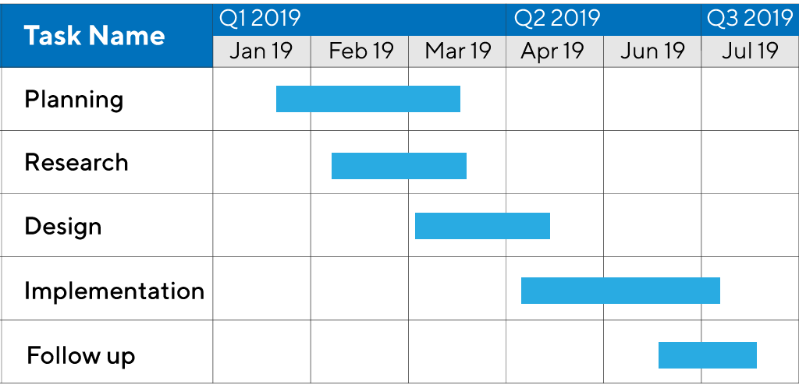
Gantt Charts

Slide 47
Network Diagram
Critical path method (CPM)
Program Evaluation and Review Technique (PERT)

Slide 48
Critical path method (CPM)
CPM is a project network analysis technique used to predict total project duration
A critical path for a project is the series of activities that determines the earliest time by which the project can be completed
The critical path is the longest path through the network diagram and has the least amount of slack or float

Slide 49
CPM
First develop a good project network diagram
Add the durations for all activities on each path through the project network diagram
How many paths are on this network diagram?
How long is each path?
Which is the critical path?
What is the shortest amount of time needed to complete this project?
Note: Assume all duration are on days

Slide 50
Constructing Network Model
A project network should have only one start node.
A project network should have only one end node.
A node has duration: A node represents an activity and, in general, activities time to execute. (Links normally have no duration)
There should not be any criss-crossing of arrows
Time moves from left to right
A network may not contain loops
A network should not contain dangle
dangling activities indicate errors in logic when activities are added as an afterthought.

Slide 51
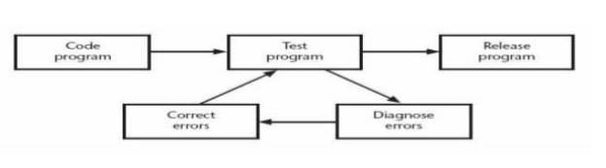
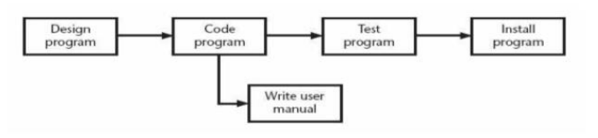
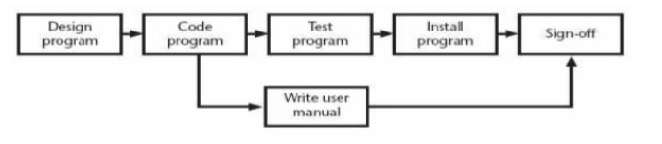
Constructing Network Model
Loop
Dangle

Slide 52
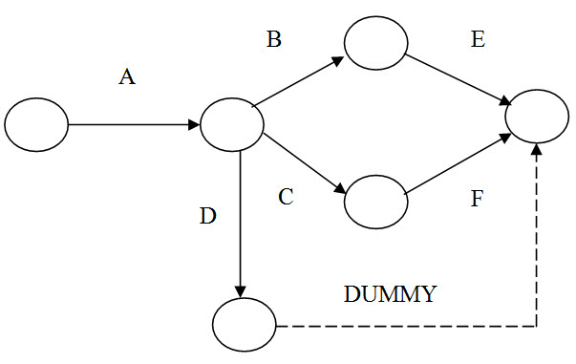
Constructing Network Model
Dummy Activity

Slide 53
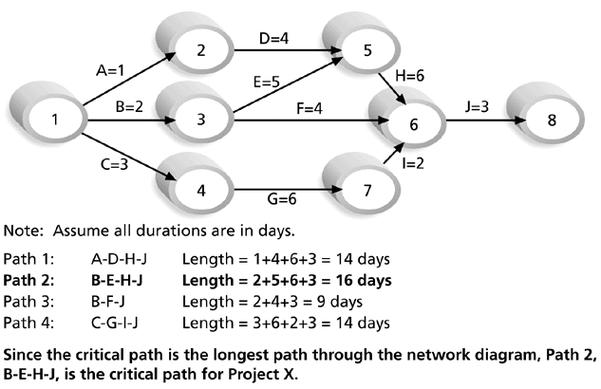
CPM

Slide 54
Ways of Finding Critical Path
Forward Pass Computation
All activities start as early as possible
Calculation from left to right
When two or more activity merges, Largest value is taken as an earliest occurrence time of the event
EST, EFT
Backward Pass Computation
All activities start as late as possible
Calculation from right to left
When two or more activity merges, small value is taken as a late occurrence time of the event
LST, LFT

Slide 55
CPM – Critical Path Method
A ( 3 )
2
D ( 5 )
1
5
B ( 4 )
E ( 2 )
C ( 7 )
3
4

Slide 56
CPM – Critical Path Method
A ( 3 )
2
D ( 5 )
0
1
5
B ( 4 )
E ( 2 )
C ( 7 )
3
4

Slide 57
CPM – Critical Path Method
3
A ( 3 )
2
D ( 5 )
0
1
5
B ( 4 )
E ( 2 )
4
C ( 7 )
3
4

Slide 58
CPM – Critical Path Method
3
A ( 3 )
2
D ( 5 )
0
1
5
B ( 4 )
E ( 2 )
4
C ( 7 )
11
3
4

Slide 59
CPM – Critical Path Method
3
13
A ( 3 )
2
D ( 5 )
0
1
5
B ( 4 )
E ( 2 )
4
C ( 7 )
11
3
4
Notes:
59
12/11/2023
Maria Petridou
University of Nottingham

Slide 60
CPM – Critical Path Method
3
13
A ( 3 )
2
D ( 5 )
8
0
1
5
B ( 4 )
E ( 2 )
4
C ( 7 )
11
3
4
Notes:
60
12/11/2023
Maria Petridou
University of Nottingham

Slide 61
CPM – Critical Path Method
3
13
A ( 3 )
8
max
2
D ( 5 )
0
1
5
B ( 4 )
E ( 2 )
4
C ( 7 )
11
3
4
Notes:
61
12/11/2023
Maria Petridou
University of Nottingham

Slide 62
CPM – Critical Path Method
3
A ( 3 )
2
D ( 5 )
0
13
1
5
B ( 4 )
E ( 2 )
4
C ( 7 )
11
3
4

Slide 63
CPM – Critical Path Method
3
A ( 3 )
2
D ( 5 )
0
13
13
1
5
B ( 4 )
E ( 2 )
4
C ( 7 )
11
3
4

Slide 64
CPM – Critical Path Method
3
A ( 3 )
2
D ( 5 )
0
13
13
1
5
B ( 4 )
E ( 2 )
4
C ( 7 )
11
11
3
4

Slide 65
CPM – Critical Path Method
3
8
A ( 3 )
2
D ( 5 )
0
13
13
1
5
B ( 4 )
E ( 2 )
4
C ( 7 )
11
11
3
4

Slide 66
CPM – Critical Path Method
3
8
A ( 3 )
2
D ( 5 )
0
13
13
1
5
B ( 4 )
E ( 2 )
4
4
C ( 7 )
11
11
3
4

Slide 67
CPM – Critical Path Method
5
3
8
A ( 3 )
2
D ( 5 )
0
13
13
1
5
B ( 4 )
E ( 2 )
4
4
C ( 7 )
11
11
3
4
Notes:
67
12/11/2023
Maria Petridou
University of Nottingham

Slide 68
CPM – Critical Path Method
5
3
8
0
A ( 3 )
2
D ( 5 )
0
13
13
1
5
B ( 4 )
E ( 2 )
4
4
C ( 7 )
11
11
3
4
Notes:
68
12/11/2023
Maria Petridou
University of Nottingham

Slide 69
CPM – Critical Path Method
5
3
8
min
0
A ( 3 )
2
D ( 5 )
0
13
13
1
5
B ( 4 )
E ( 2 )
4
4
C ( 7 )
11
11
3
4
Notes:
69
12/11/2023
Maria Petridou
University of Nottingham

Slide 70
CPM – Critical Path Method
3
8
A ( 3 )
2
D ( 5 )
0
0
13
13
1
5
B ( 4 )
E ( 2 )
4
4
C ( 7 )
11
11
3
4

Slide 71
Calculate processing times for each activity.
For each activity X with start node i and end node j:
ES(X) = ET(i)
EF(X) = ES(X) + t(X)
LF(X) = LT(j)
LS(X) = LF(X) – t(X)
Slack Time (X) = LS(X) – ES(X) = LF(X) – EF(X)
Where t(X) is the duration of activity X.
An activity with zero slack time is a critical activity and cannot be delayed without causing a delay in the whole project.

Slide 72
CPM – Critical Path Method
Task | Duration | ES | EF | LS | LF | Slack | Critical Task
A | 3 | 0 | 3 | 5 | 8 | 5 | No
B | 4 | 0 | 4 | 0 | 4 | 0 | Yes
C | 7 | 4 | 11 | 4 | 11 | 0 | Yes
D | 5 | 3 | 8 | 8 | 13 | 5 | No
E | 2 | 11 | 13 | 11 | 13 | 0 | Yes

Slide 73
CPM – Critical Path Method
5
3
8
min
13
0
A ( 3 )
8
max
2
D ( 5 )
0
0
13
13
1
5
B ( 4 )
E ( 2 )
4
4
C ( 7 )
11
11
3
4

Slide 74
CPM – Critical Path Method
Activity | Predecessor | Time (Weeks)
A | - | 4
B | A | 6
C | B | 2
D | C | 5
E | C | 2
F | D | 7
G | E | 4
H | F,G | 1

Slide 75
Solution
E= 17
L= 17
5
E= 24
L= 24
E= 0
L= 0
E= 4
L= 4
E= 10
L= 10
D
F
A
B
C
H
1
2
3
4
7
8
E= 25
L= 25
E= 12
L= 12
E
6
G
E= 14
L= 14
Critical Path :1- 2- 3- 4- 5- 7- 8
25 weeks
Non critical path : 1- 2- 3- 4- 6- 7- 8
19 weeks
Float
6 weeks

Slide 76
Program Evaluation and Review Technique (PERT)
PERT is a network analysis technique used to estimate project duration when there is a high degree of uncertainty about the individual activity duration estimates
PERT uses probabilistic time estimates based on using optimistic, most likely, and pessimistic estimates of activity durations
PERT weighted average formula:
optimistic time + 4X most likely time + pessimistic time
6

Slide 77
Program Evaluation and Review Technique (PERT)
Example:
PERT weighted average =8 workdays + 4 X 10 workdays + 24 workdays = 12 days 6
where 8 = optimistic time, 10 = most likely time, and 24 = pessimistic time
Standard Deviation = Pessimistic time-Optimistic time 6
Variance= (standard Deviation) 2
Probability of completing the project within given time= Observed Value-Mean Value Standard Deviation of critical path

Slide 78
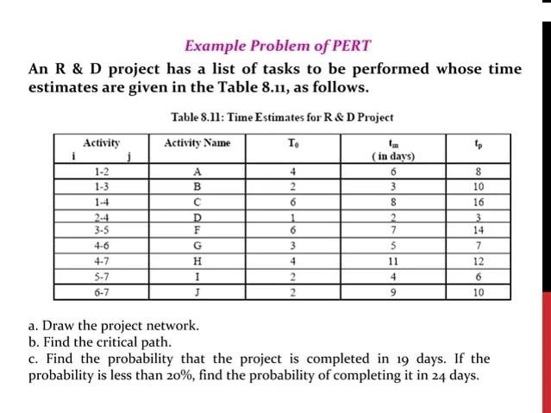

Slide 79
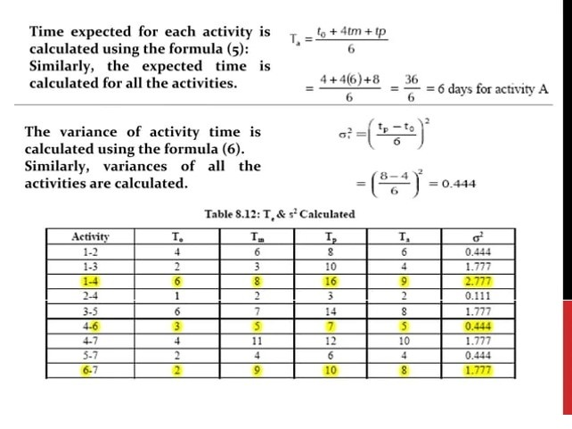

Slide 80
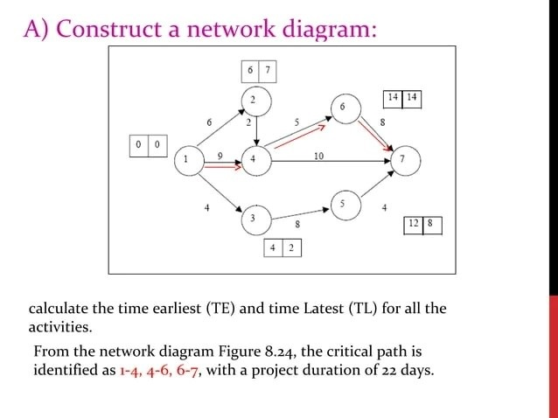

Slide 81
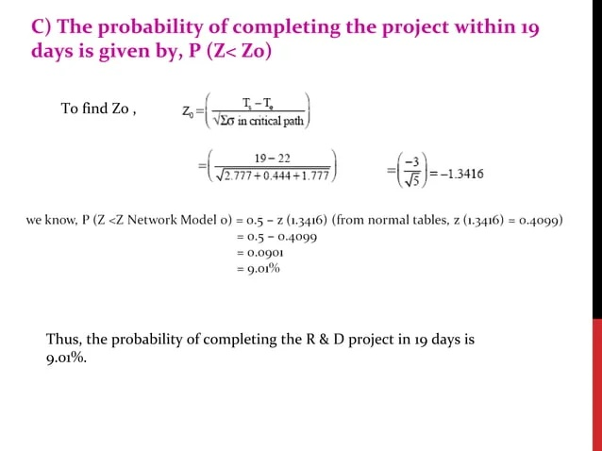

Slide 82
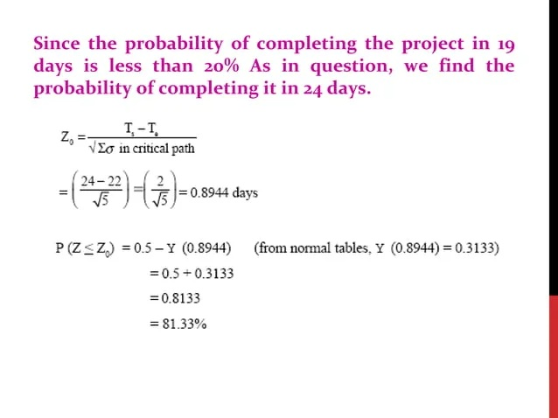

Slide 83
CPM vs PERT
CPM | PERT
Critical Path Method | Project Evaluation & Review Technique
Developed by US Engineer, working at DuPoint Company (1956), construction of chemical plant | Developed by US Navy Engineers, working on large military development programs, specially on its Polarish Weapon System in 1958
Activity Oriented | Event oriented
Deterministic Activities | Probability Activities
Used for project construction | Used for research & development
Single time estimate | Three time estimate: Pessimistic, Optimistic, Most likely time
Focus on time, cost and quality | Focus on time and quality without constraint cost

Slide 84
Terminology Of The Networking Technique
Network
Activity
Critical activity
Non-critical activity
Dummy activity
Event
Tail event
Head event
Dual role/event
Float
Total float
Free float
Independent float
Slack time
Earliest start time (EST)
Earliest finish time (EFT)
Latest start time (LST)
Latest finish time (LFT)
Forward pass (FWP)
Backward pass (BWP)

Slide 85
Slack/Float
Slack or float = LST-EST or LFT-EFT
Total float (TF)= LFT of head Event (event 2) – EST of tail event (event 1) –duration of activity
Maximum time from which the completion of activity can be delayed without affecting the project completion date
LST-EST or LFT-EFT or L(j)-E(i)-d
Free float (FF) = EST of head Event (event 2)- EST of tail event (event 1) - duration of activity
Delay that can be permitted in an activity so that succeeding activity in the path are not affected
EST of succeeding activity same
EFT-EST-d or E(j)-E(i)-d
Independent float(IDF)=EST of head Event (event 2) – LFT of tail event (event 1)–duration of activity
Started as late as possible and finish as early as possible
E(j)-E(i)-d
Interfering float(IFF)= total float –free float
TF<=FF<=IDF<=IFF
TF>=FF>=IDF>=IFF
???

Slide 86
Precedence Diagram Method (PDM)
Also Called Activity on Node (AON)
where the nodes represent activities
In the nodes, the activity time and the early and late start and finish times are represented in the following manner
A 2
C 2
F 3
E 4
H 2
Start
Finish
B 3
D 4
G 5
ACTIVITY t
ES EF
LS LF

Slide 87
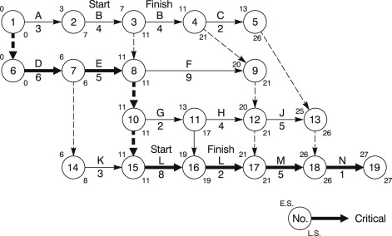
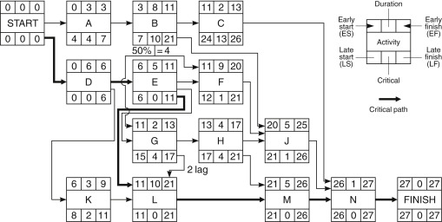

Slide 88
Example
Activity | Predecessor | Successor | Time (Weeks)
A | - | D | 3
B | - | E,G,I | 6
C | - | F | 2
D | A | G | 2
E | B | H | 1
F | C | I | 3
G | B,D | - | 7
H | E | - | 3
I | B,F | - | 4

